Slide 1
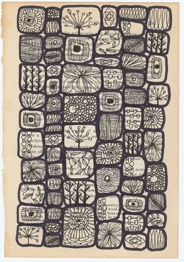
Texture
Texture, another element of art, is used to describe either the way a three-dimensional work actually feels when touched, or the visual "feel" of a two-dimensional work.
Take rocks, for example. A real, 3-D rock might feel rough or smooth, and definitely feels hard when touched or picked up. A painter, depicting a rock, would create the illusions of these qualities through use of color, line, shape, etc.

Slide 2
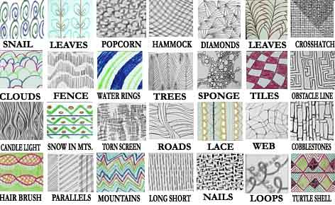
TEXTURE
Each of these drawings shows artistic interpretation of everyday items using
LINE and TONE.

Slide 3
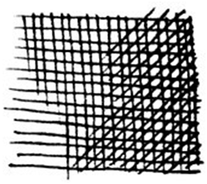
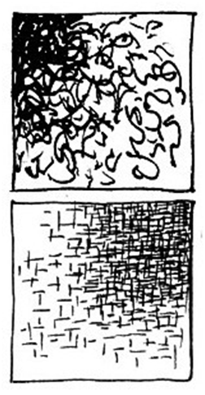
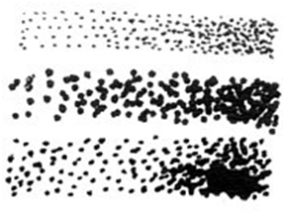
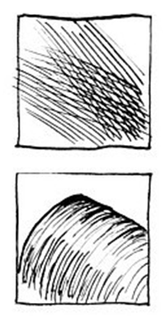
What is TEXTURE? Each of these drawings shows artistic interpretation of everyday items using LINE and TONE. Here are some DRAWING TECHNIQUES for you to try:
Scumbling
Cross-hatching
Stippling
Hatching
Contour-hatching
Random Hatching

Slide 4
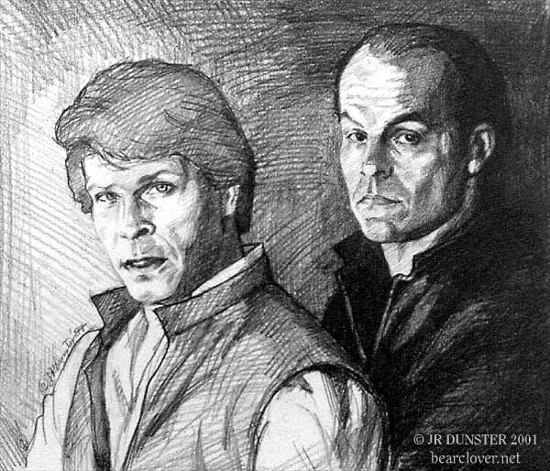
Textured Drawing
Foreground and background

Slide 5
Home work for Friday 1st Nov
Finish texture page
At least 6 more textures at home
You will get sketchbook grades in Experimentation and technique and
Presentation
So take your time

