Slide 1
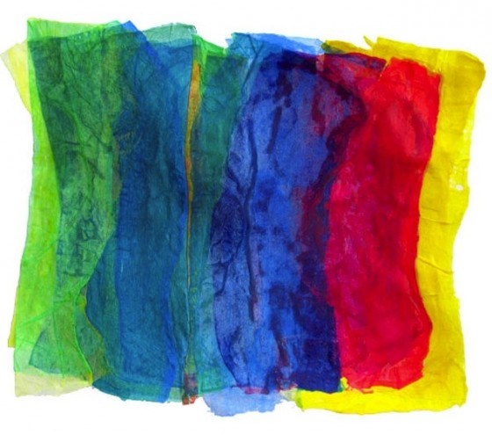
Plastic Fantastic
Plastic Fusing

Slide 2
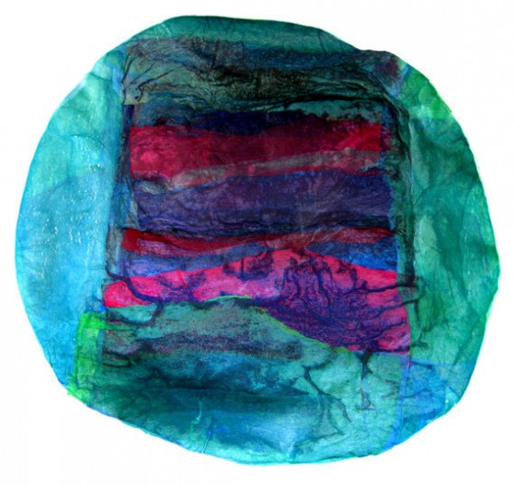
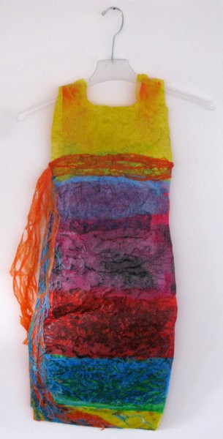
http://www.greenprophet.com/2011/11/plastic-bags-art/
Israeli artist Aviva Sawicki
Colorful plastic bags are both the canvas and the paints in Aviva Sawicki’s artworks.
Plastic bags are a ubiquitous and un-eco-friendly material that many sustainable and upcycling designers have tried to reuse. One designer has turned plastic bags into shoes, another has made plastic bag wallets, and plastic bags can even be used as crocheting material to knit reusable shopping bags. There does seem to be a common trend among these designers, though, in that they fuse plastic bags together in order to make them more durable, usable, and pliable.

Slide 3
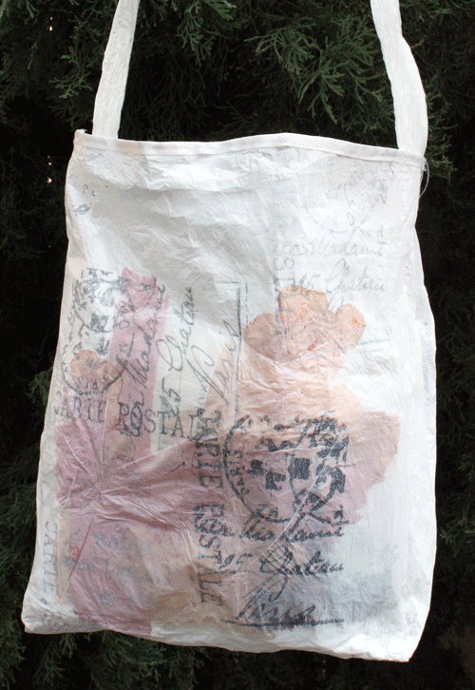
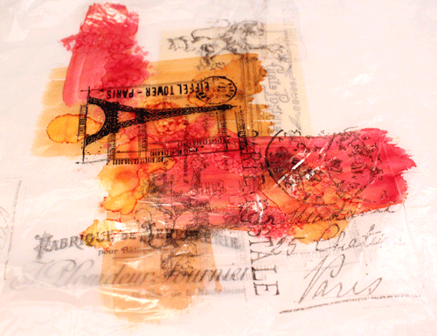
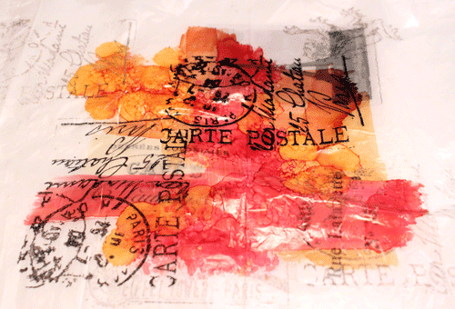
http://somethingcreatedeveryday.blogspot.com/2011/07/fused-bar-art.html
“Because the plastic bags are non-porous it was the perfect surface to use alcohol inks. I applied the inks directly onto one layer of plastic. Next, I used permanent black ink and rubber stamped several designs. Here is how the art started off.”

Slide 4
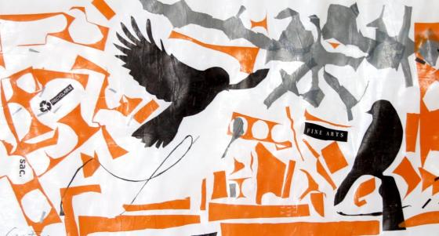
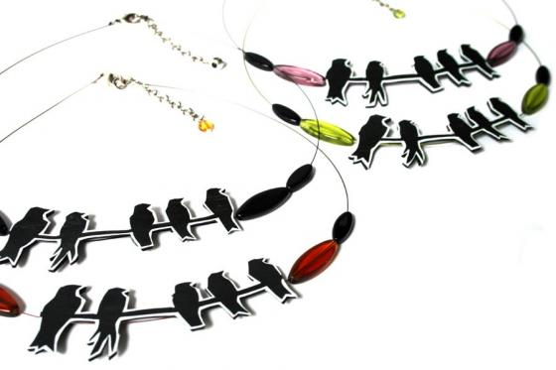
http://tryhandmade.com/plastic-fantastic/
Melanie Casavant, the creative force behind Okzoo is an artist and jewelry designer who is doing some amazing things with fused plastic bags in her Montreal studio. Six years ago, she was concerned by the ever-growing pile of plastic shopping bags collecting in her kitchen. Recognizing the opportunity to make something beautiful of a commonplace and under-explored material, Melanie was inspired to experiment with fused plastic. Once she discovered the perfect combination of heat and pressure on the plastic, the possibilities were endless.
Ultra-lightweight and ultra-cool, above the necklace made from fused plastic and glass beads is just one of the fresh and eye-catching items.

Slide 5
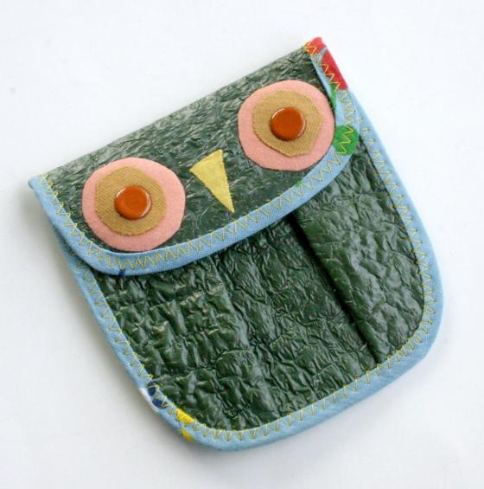
http://tryhandmade.com/plastic-fantastic/
Another talented “green” artisan working with fused plastic is Brooke of So She Sews. Brooke creates adorable coin purses, coffee sleeves, purses and wallets from plastic retail bags, dry cleaning bags and fabric scraps. The plastic-fusing process creates a finished product that is both sturdy and pliable. Brooke calls it an “eco-textile”. I call it eco-fabulous and I’m sure you’ll agree!
Make a statement and let this little coin purse tell the world that you give a “hoot” about the environment. Each wallet is made by hand, one-of-a-kind and adorable. And, as with all of the recycled pieces in Brooke’s shop, perfectly affordable. (By the way, while you’re browsing Brooke’s shop, be sure to check out her profile page for details on her commitment to reusing salvaged materials and reducing packaging waste. All of the packages from the So She Sews shop are shipped with as much thought and consideration for the environment as the items inside them. I like that!)

Slide 6
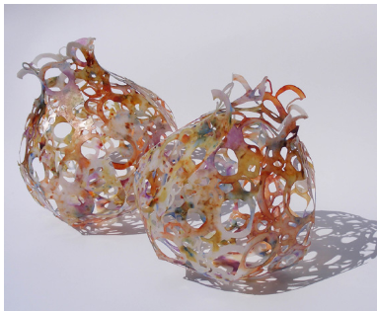
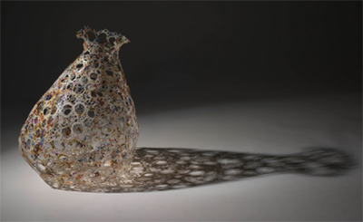
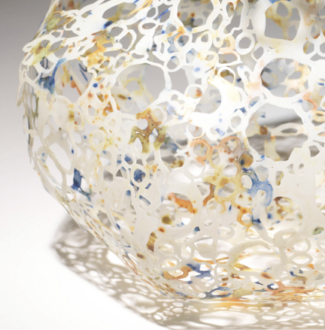
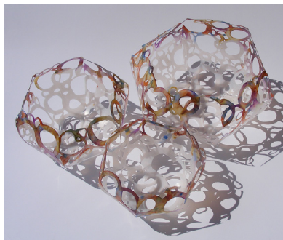
http://www.dailyartmuse.com/2009/03/12/caroline-saul-plastic-makes-perfect/
Caroline Saul: plastic makes perfect
These painterly vessels appear to be delicate translucent porcelain with surface designs akin to burnt velvet, raku and nuno felt
Clever Caroline Saul tricks the eye with her weightless sculptural containers, which are actually made from recycled plastic milk bottles. Saul melts and fuses the plastic into sheets she tints, cuts and shapes to create small bowls, large plump orbs and installation sized vessels. I was pulled in by the colors and quickly caught in the net of shadows cast by the lacy structures
“My passion lies with the creation of new materials from objects that might otherwise be thrown away. The development of my recycled plastics leads to the creation of sculptural bulbous vessels”

