Slide 1
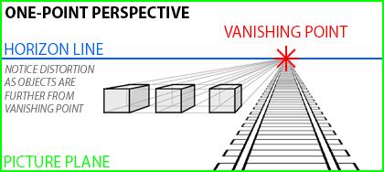
One point perspective.
One-point perspective images have a tendency to draw the viewer along the lines to the vanishing point. This effect can be used to greater advantage by placing the subject of an image in front of or near the vanishing point. The viewers will more naturally focus their attention because most of the lines in the image converge onto that area.

Slide 2
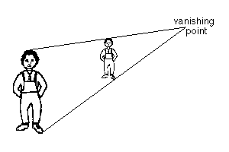
Distant figures appear smaller but have the same shape and proportions as they would close up.

Slide 3
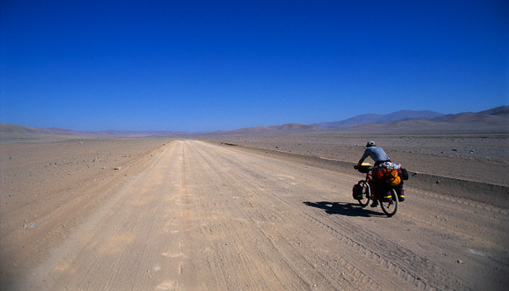
It's a long road home...

Slide 4
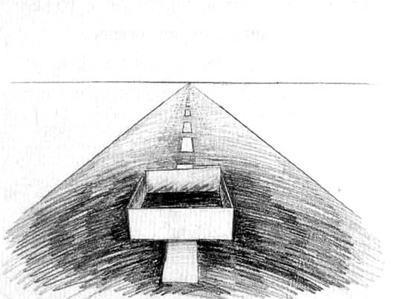
Task: Draw a road in one point perspective. It should disappear into the horizon and be divided in two so cars can travel on both sides.

Slide 5
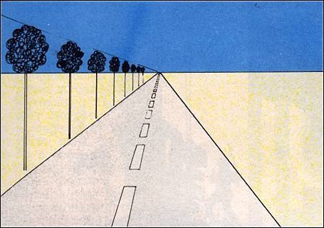
Task:
Draw the road
Add a sky with clouds
and some grass on the verge of the road
Add some trees

Slide 6
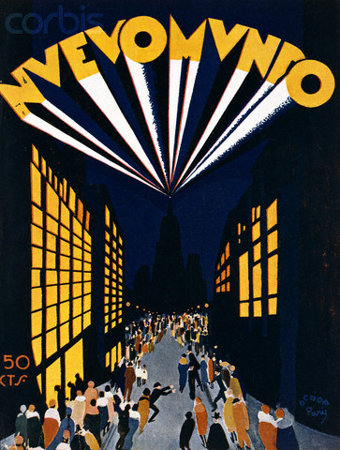
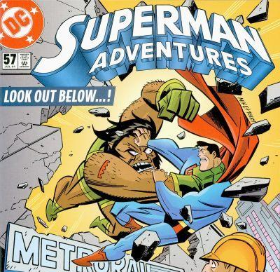
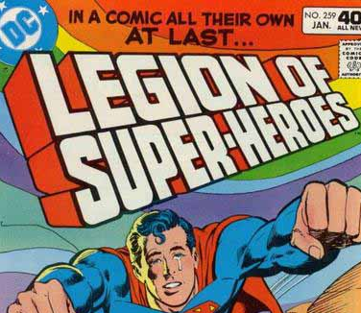
Examples of
one point perspective!
Task: Design your own comic book front cover with a one point perspective title and a new superhero of your own invention!

Slide 7
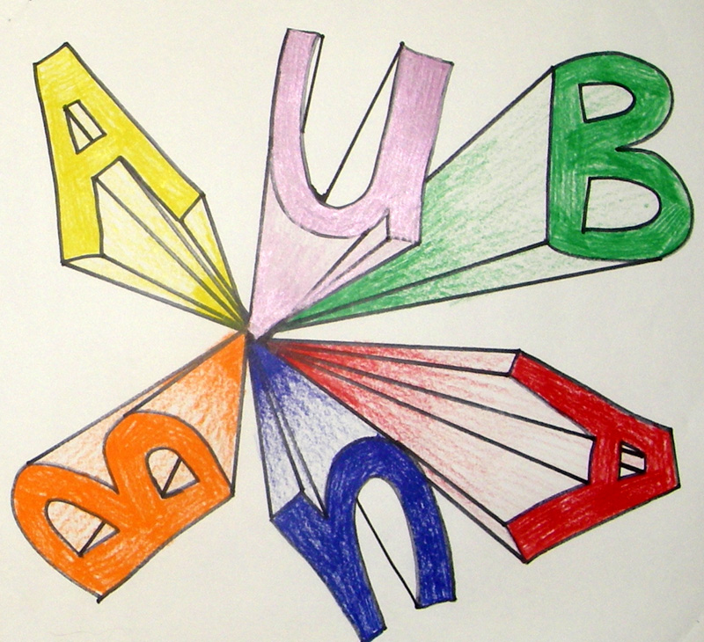
Extension 1: If finished draw your initials in one point perspective but going different ways

Slide 8
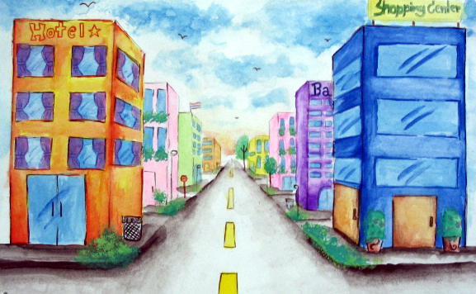
Extension 2: If finished draw a city scene in one point perspective.

Slide 9
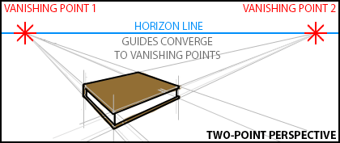
Two point perspective.
Because we view most objects from an angle, and not directly from the front or sides, two-point perspective allows us to represent our world more realistically. Two Point Perspective is a much more useful drawing system than One Point Perspective. Objects drawn in two point perspective have a more natural look.

Slide 10
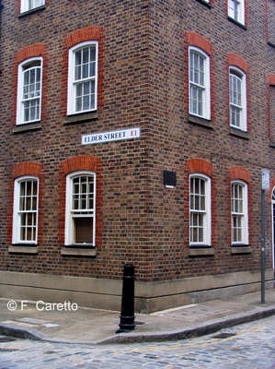
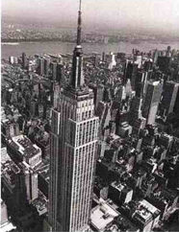
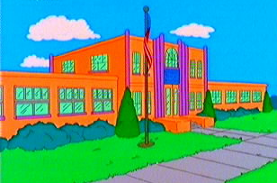
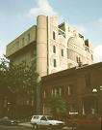
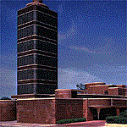
Examples of
two point perspective!

Slide 11
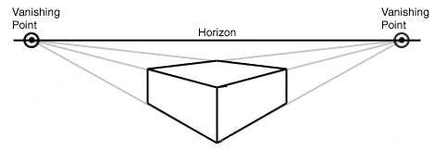
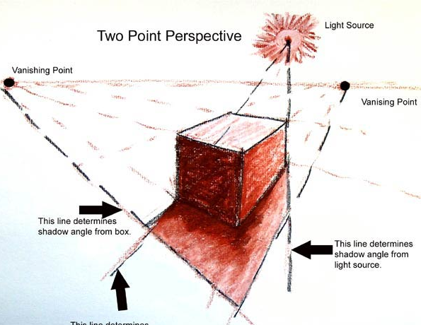
Task: Draw a simple box in two point perspective and add a light and a dark.

Slide 12
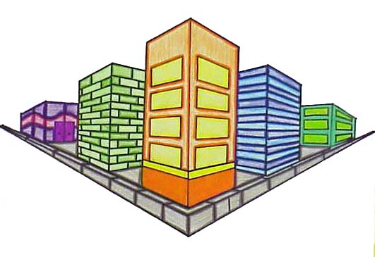
Task: Draw a two point perspective city

Slide 13
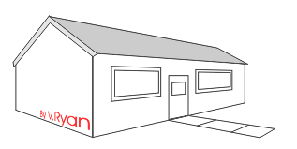
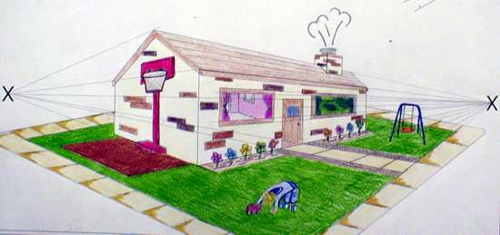
Task: Follow the instructions from www.technologystudent.com/designpro/perhous2.htm to draw this house in 2 point perspective.
Add a fence
Add sky
Add curtains
Add two other details to make it look like a home!

