Slide 1
MOVEMENT WITHIN ART

Slide 2
The invention of motion pictures introduced the element of movement to visual language. Edweard Muybridge has been credited for first developing the idea of taking a series of photographs that combined could be viewed as a moving picture, actually done to settle a bet as to whether all four feet of a galloping horse were ever off the ground at the same time. This first motion picture was made in 1872.

Slide 3
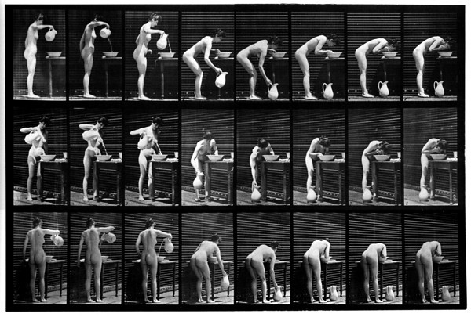
Edweard Muybridge.
Most artists who use the idea of movement in their works will at some time resort back to the work of this photographer.
Takes photos of the figure in action in the 1880s in California.
His book Human and animal locomotion was a major influence on the way we see and portray movement today.
Spelled his name in a number of ways just to confuse you!!!

Slide 4
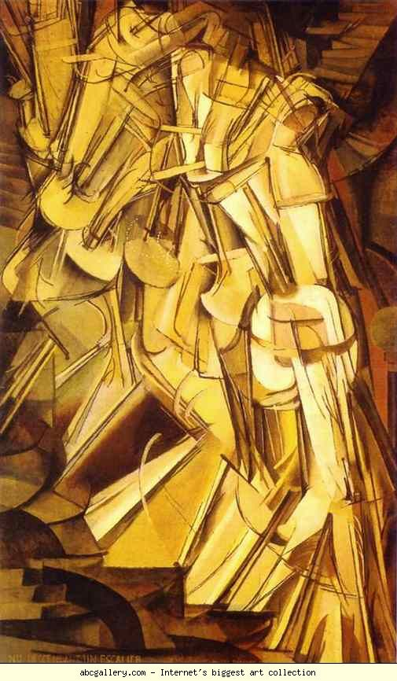
Marcel Duchamp, Nude Descending Staircase, 1912
New approaches were suggested by the multiple frame images of motion picture film, and stop action photography. Futurist painters such as Balla used these ideas to celebrate speed and movement. Marcel Duchamp's Nude Descending a Staircase also attempted to capture the entire sequence of action through "stop-action" imagery.
Oil-Painting

Slide 5
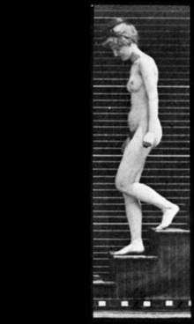
Eadweard Muybridge: Woman Walking Downstairs - 1887

Slide 6
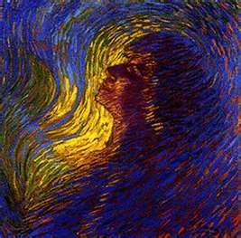
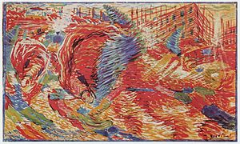
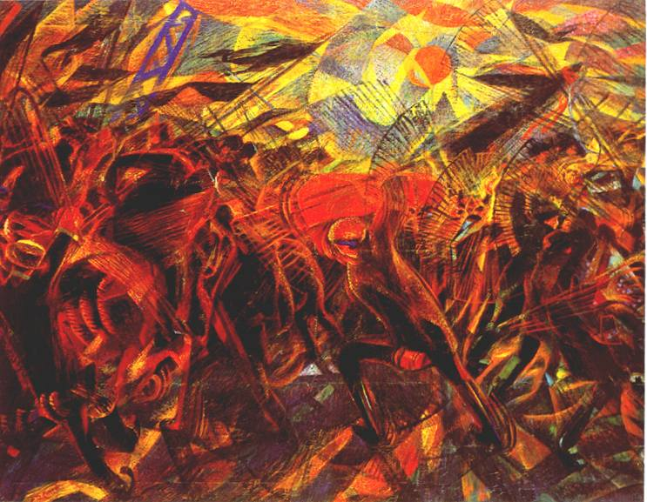
Futurism
An art movement inspired by machines where artists wanted to portray movement. They did this by drawing objects/people in different stages of movement and linking the stages together.
Luigi Russol.
Luigi Russolo, Plastic Synthesis of the Actions of a Woman , 1911
Umberto Boccioni,The City Rises, 1910
Funeral of the Anarchist Galli by Carlo Carrà, 1911

Slide 7
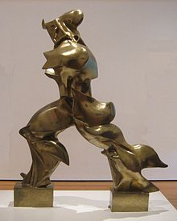
Futurism:
social movement
Italy
Early 20th century.
Emphasized and glorified themes associated with contemporary concepts of the future: speed, technology, youth and violence, and objects such as the car, the airplane and the industrial city.
Painting, sculpture, ceramics, graphic design, industrial design, interior design, urban design, theatre, film, fashion, textiles, literature, music, architecture and even gastronomy.
Futurism influenced art movements such as Art Deco, Constructivism, Surrealism, Dada, and to a greater degree, Precisionism, Rayonism, and Vorticism.
Boccioni's sculpture, Unique Forms of Continuity in Space, and Balla's painting, Abstract Speed + Sound, 1913

Slide 8
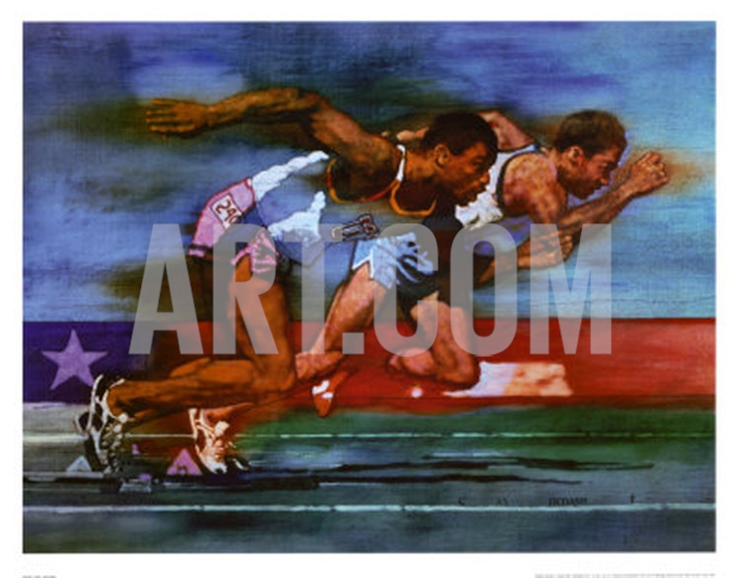
Olympic Track and Field By Michael C. Dudash 71 x 56 cm

Slide 9
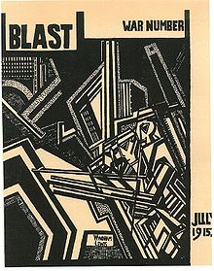
Wyndham Lewis and friends. This edition included an article by Henri Gaudier-Brzeska written and submitted from the trenches of WWI. Date 1915 (publication)
The cover of the last edition of BLAST, the literary magazine of the British Vorticist movement, a movement heavily influenced by Futurism

Slide 10
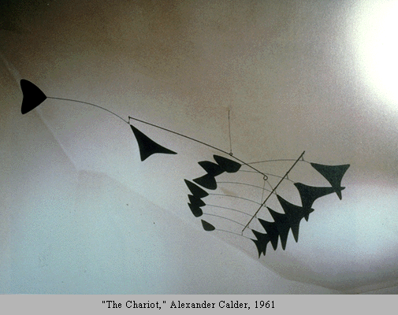
Alexander Calder began to create sculptures that actually moved, which he called mobiles. Subsequently many artists have used movement involving mechanical or electronic means that bridged the worlds of art and engineering.

Slide 11
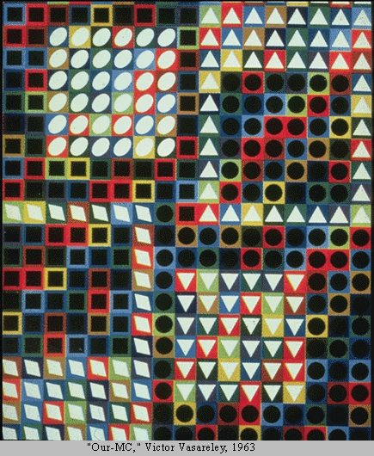
Compositional Movement - Static
Another way to think about movement is to consider how the viewer's eye moves through the composition. This is what we refer to as compositional movement. In this case we are not concerned with the presence (or lack of) implied motion in the image. We are concerned instead with how the viewer perceives the composition-- how the components relate and lead the viewer's attention.
Optical Artist – Victor Vasarerely

Slide 12
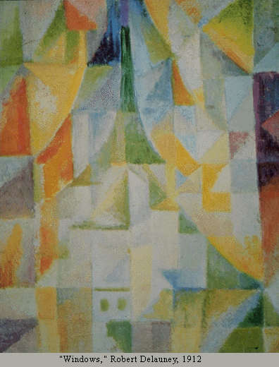
Composition Movement - dynamic
Movement may also be classified as dynamic. Dynamic movement is characterized by movement of the eye that flows smoothly from one area of the composition to another, guided by continuations of line or form, and by gradations of color. Dynamic movement is characterized by open shapes or shapes that closely relate to adjacent shapes.

Slide 13
http://char.txa.cornell.edu/language/element/move/move.htm

Slide 14
WHY DO ARTISTS WANT TO SHOW MOVEMENT??

Slide 15
Which phrase best describes why artists use movement in their artwork?
To draw the viewer's attention away from unimportant areas – to important areas To keep the viewer from looking at areas that are unfinished To allow the viewer's eye to drift out of the artwork To help the viewer's eye travel from one area to another
To create a story

Slide 16
Write a Brief History of How Artists portray movement. Study specific artists, compare and contrast.

