Slide 1
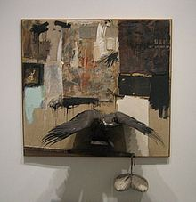

Slide 2
Robert Rauschenberg (October 22, 1925 – May 12, 2008) was an American painter and graphic artist whose early works anticipated the pop art movement. Rauschenberg is well known for his "Combines" of the 1950s, in which non-traditional materials and objects were employed in innovative combinations. Rauschenberg was both a painter and a sculptor and the Combines are a combination of both, but he also worked with photography, printmaking, papermaking, and performance.^{[1][2]} He was awarded the National Medal of Arts in 1993
Canyon (1959)

Slide 3
Mixed media, in visual art, refers to an artwork in the making of which more than one medium has been employed. There is an important distinction between "mixed-media" artworks and "multimedia art". Mixed media tends to refer to a work of visual art that combines various traditionally distinct visual art media. For example, a work on canvas that combines paint, ink, and collage could properly be called a "mixed media" work - but not a work of "multimedia art." The term multimedia art implies a broader scope than mixed media, combining visual art with non-visual elements (such as recorded sound, for example) or with elements of the other arts (such as literature, drama, dance, motion graphics, music, or interactivity).

