Slide 1
A History of Kinetic Art
“Kinetic art was created by artists who pushed the boundaries of traditional, static art forms to introduce visual experiences that would engage the audience and profoundly change the course of modern art”. –Theo Jansen
http://intlkineticartevent.org/?page_id=107

Slide 2
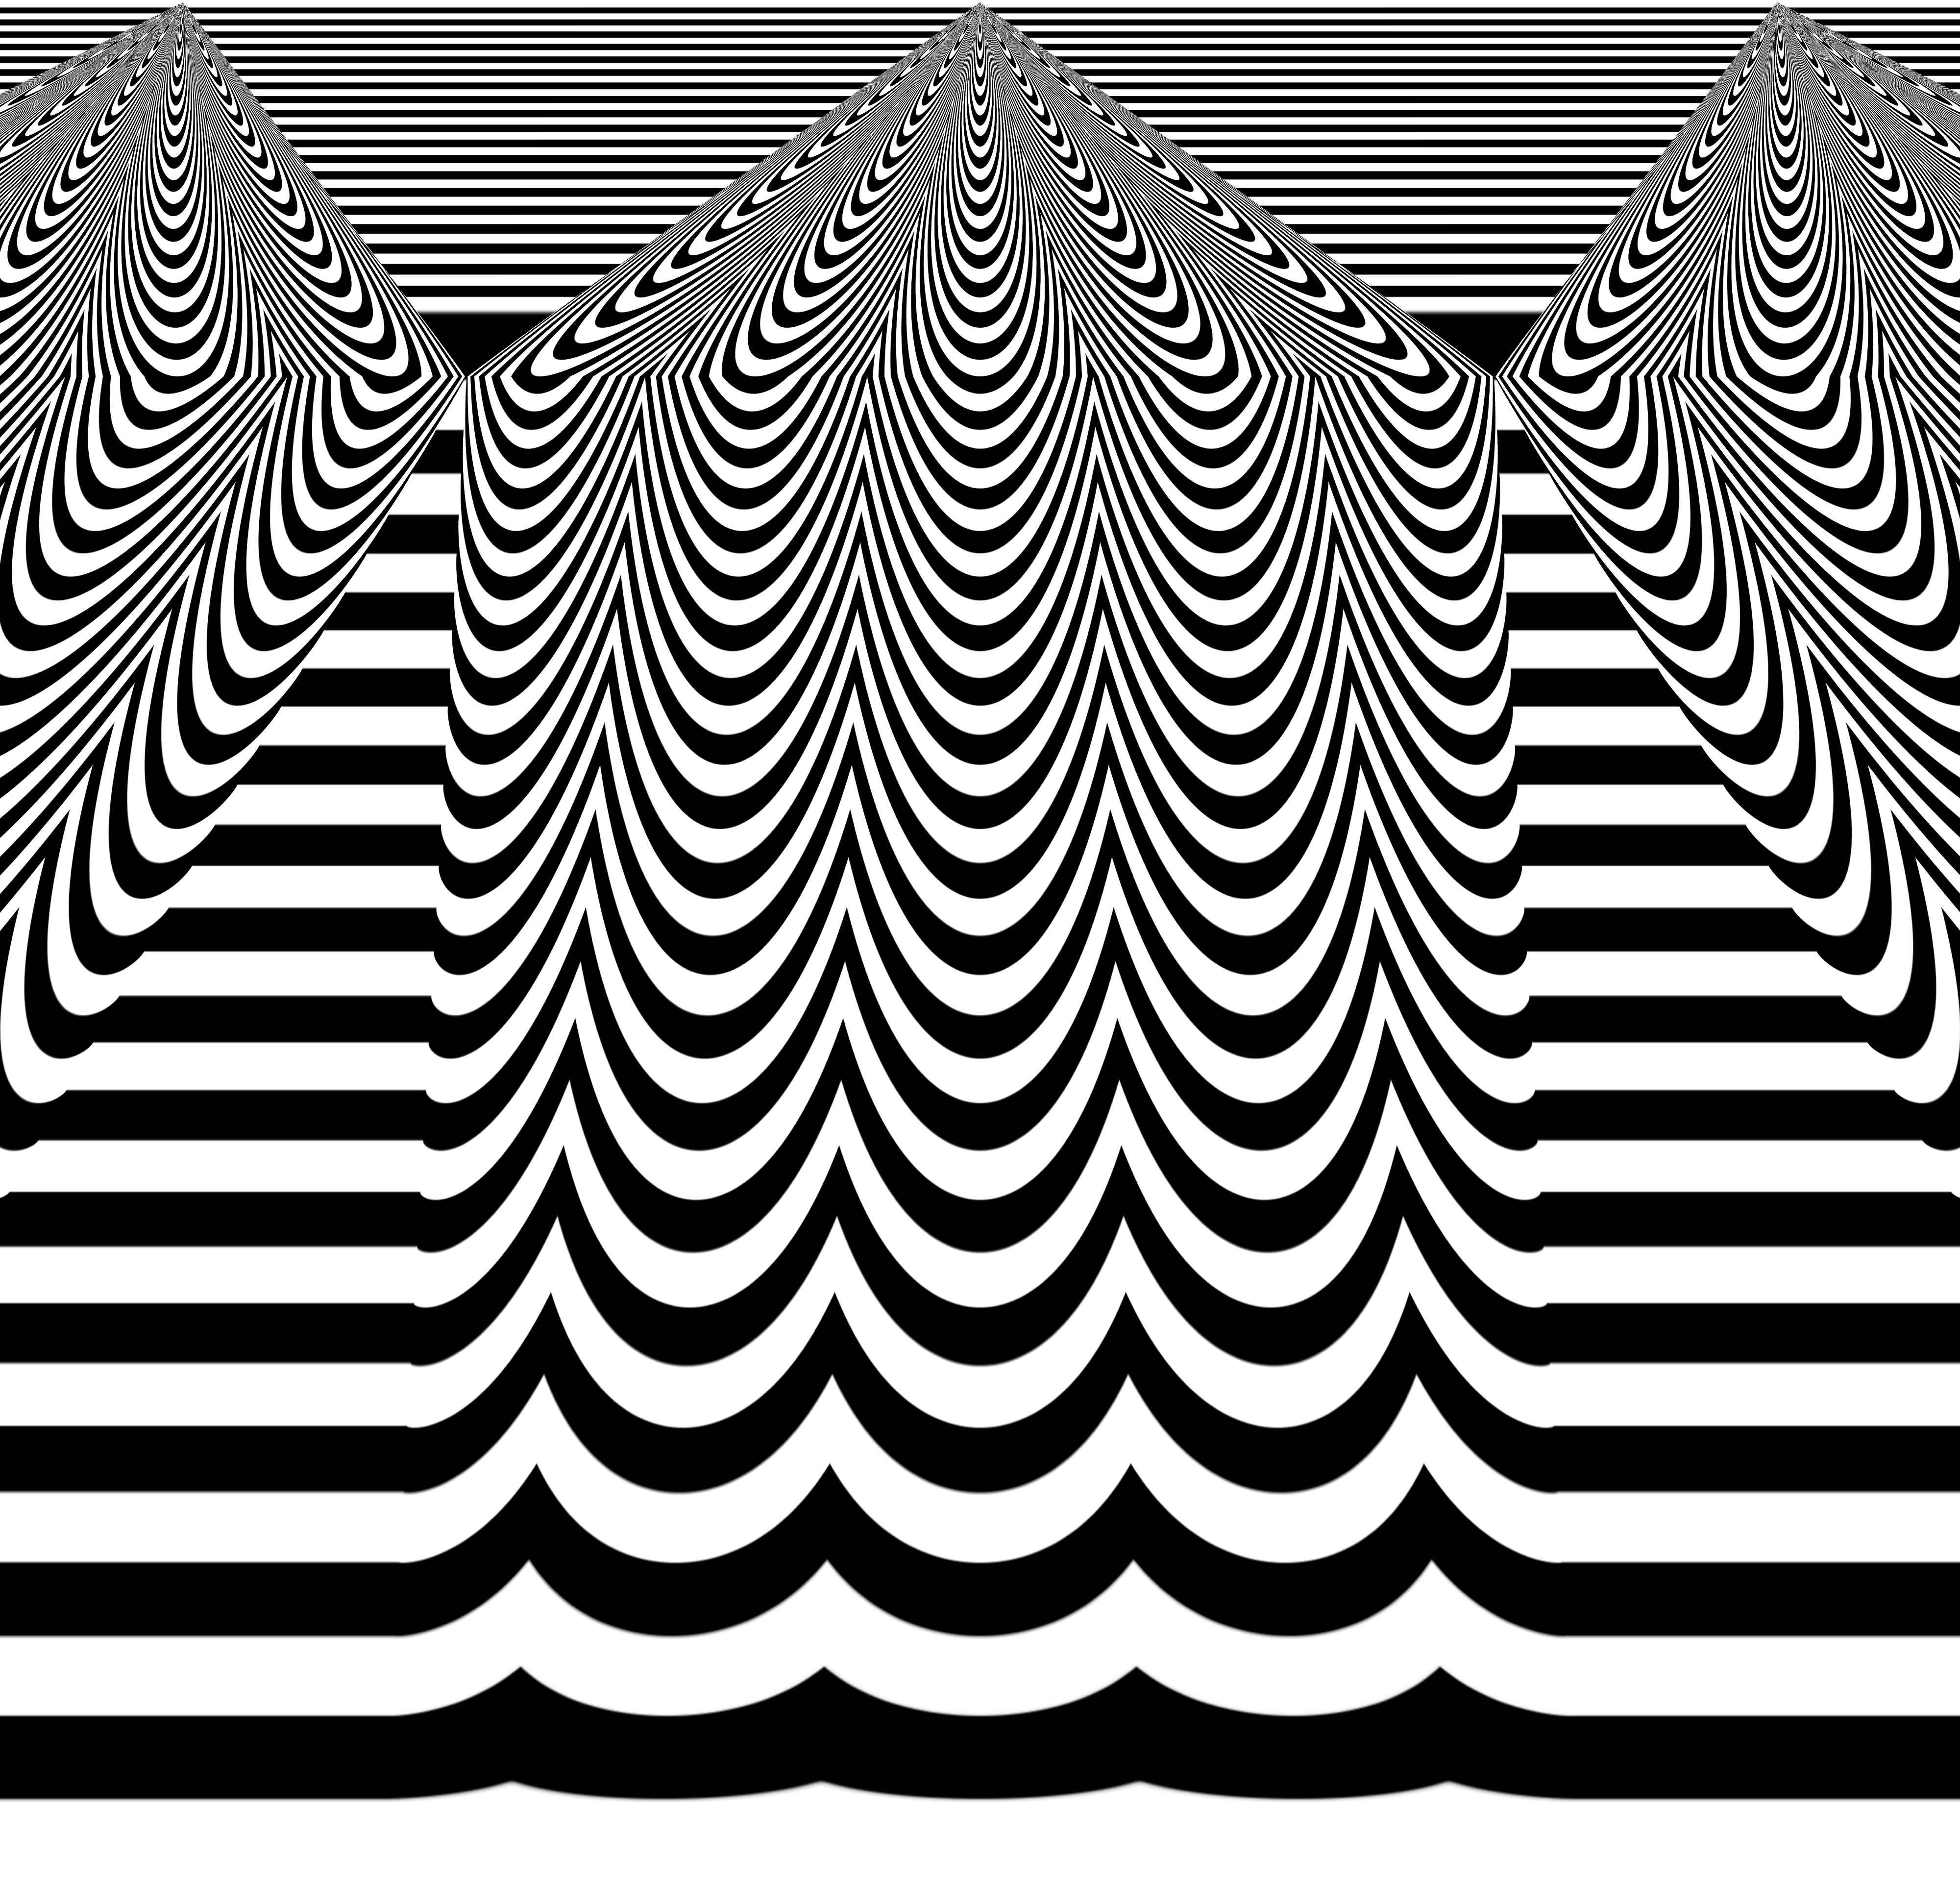
Although its history is deep, Kinetic art wasn’t established as a major artistic movement until the 1950s

Slide 3
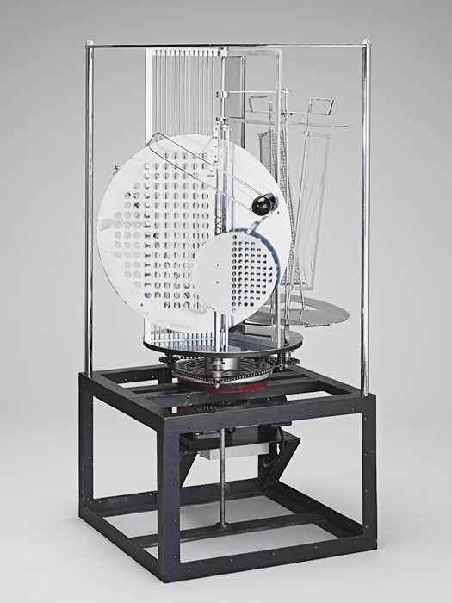
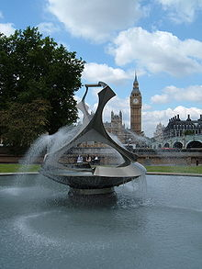
Kinetic Art has been around since the early 20th century but it did not become a modern art form until a few artists, including the below began to use electric machinery in their sculptures
Laszlo Moholy-Nagy
Naum Gabo
http://www.youtube.com/watch?v=fNt39WJQqjg
http://youtu.be/2CeSVnQLdXw
"Revolving Torsion" kinetic sculpture/fountain
Light Prop for an Electric Stage,

Slide 4
In the 1950 and 60s however in Europe, Kinetic Art fell out of fashion because the mechanical age ushered in a digital era and artists began to experiment with computers video, film and lasers.
Interest in Kinetic art concepts dates back to 1913 during the…..

Slide 5
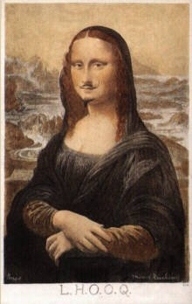
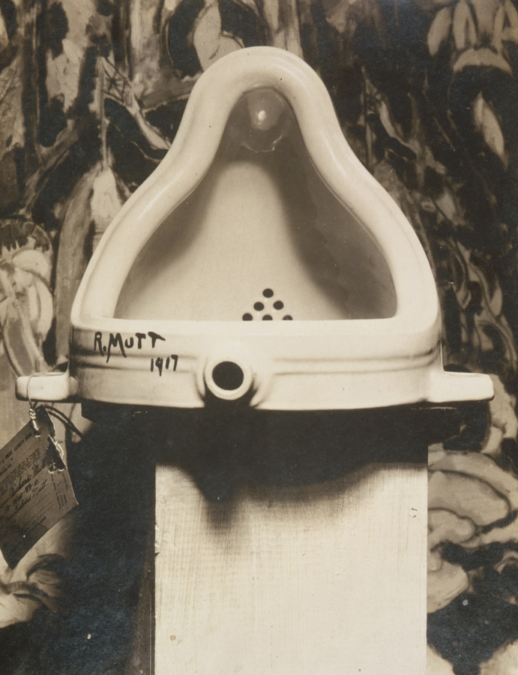
Dada Art Movement
Using an early form of Shock Art, the Dadaists thrust mild obscenities, scatological humor, visual puns and everyday objects (renamed as "art") into the public eye

Slide 6
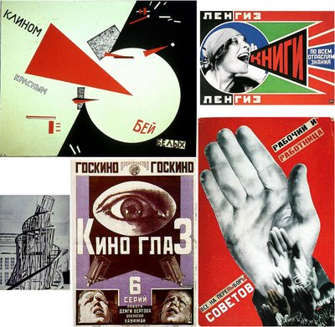
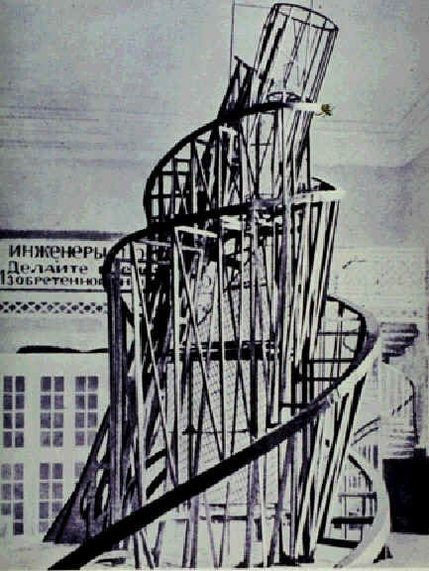
Constructivism
Constructivism was an artistic and architectural philosophy that originated in Russia beginning in 1919, which was a rejection of the idea of autonomous art. The movement was in favour of art as a practice for social purposes. ...

Slide 7
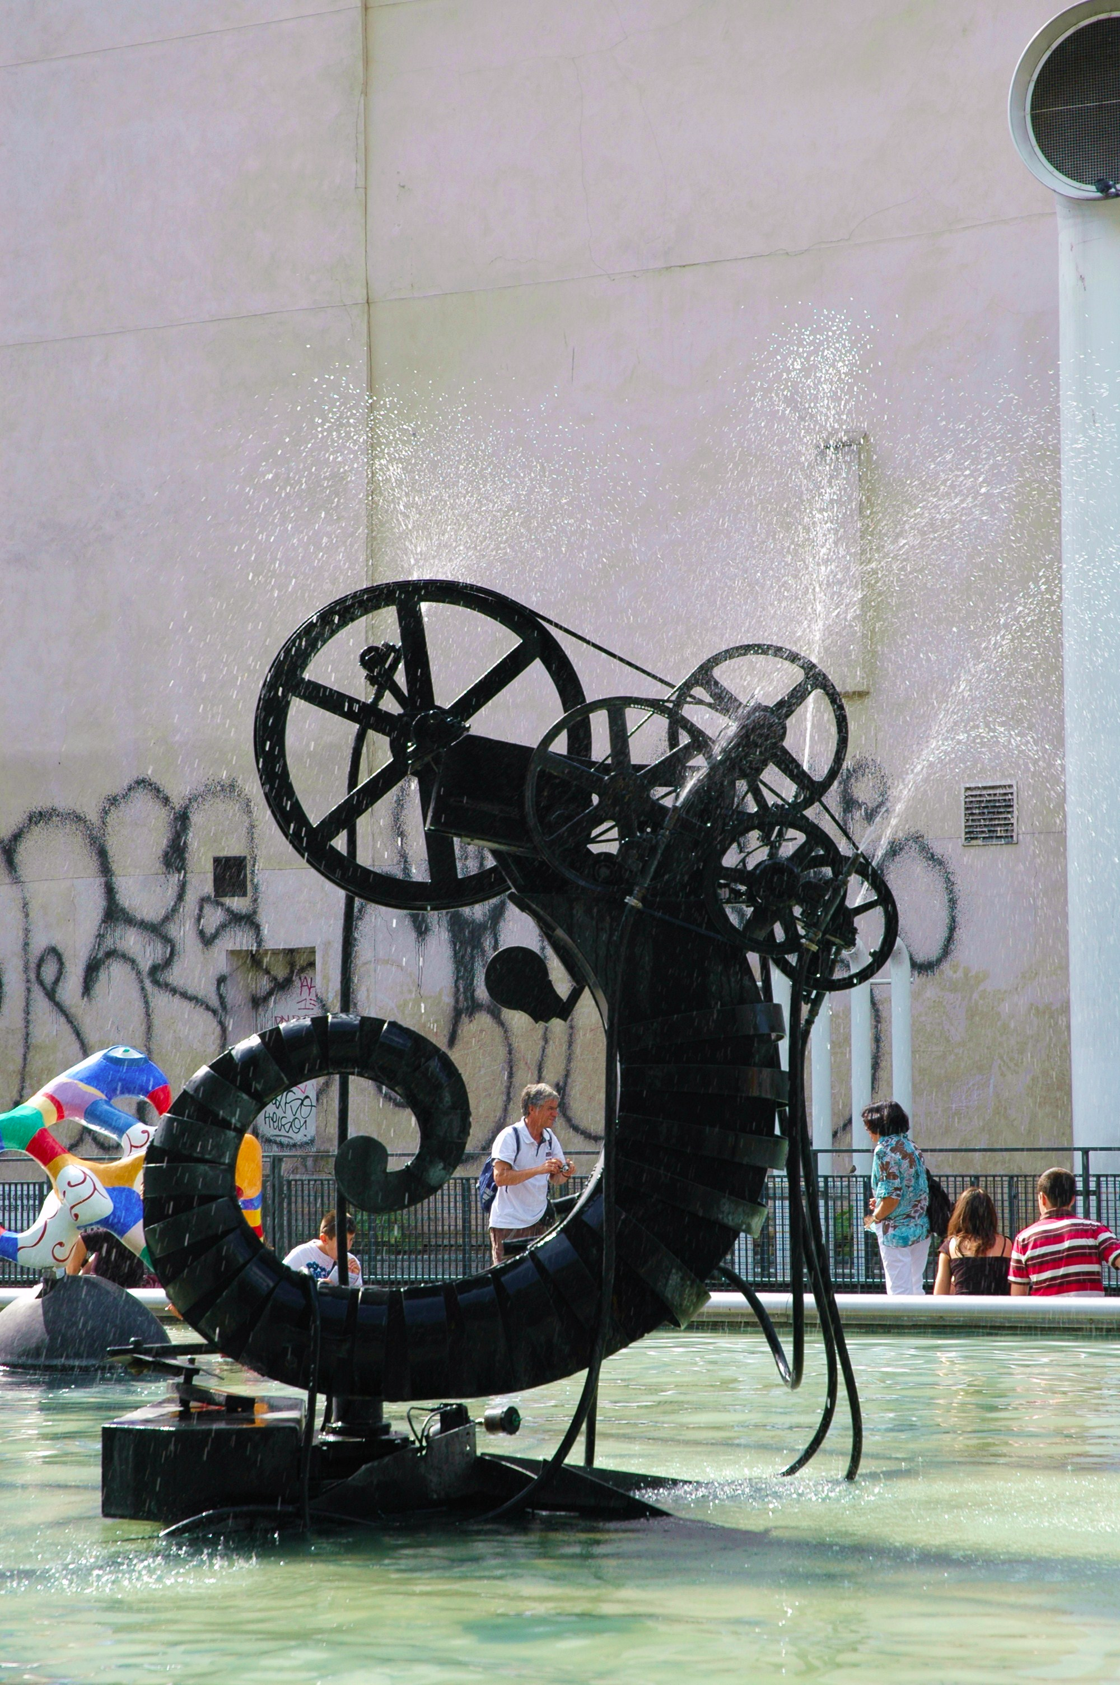
Artists like Jean Tinguely, a Swiss painter and sculptor, were fascinated by the possibilities of movement in art and the potential to create interactive relationships and visual experiences that went beyond the boundaries of traditional, static objects. Tinguely created sculptures that would have a more active presence both in the gallery and outside.
«The only imaginable static (stability) is life itself, is evolution – is movement.» (Jean Tinguely, Düsseldorf, March 1959)

Slide 8
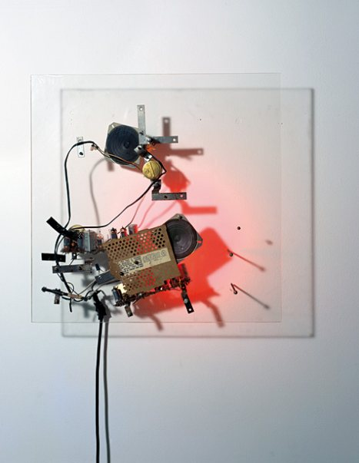
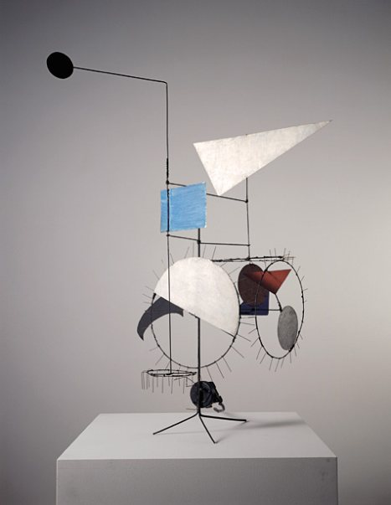
His signature pieces included anthropomorphic assemblages of motors and light as well as brightly colored metal wheels. He encouraged the idea that the beauty of an object could be the product of optical illusions or mechanical movement.
http://youtu.be/b4iXF-LIYi0

Slide 9
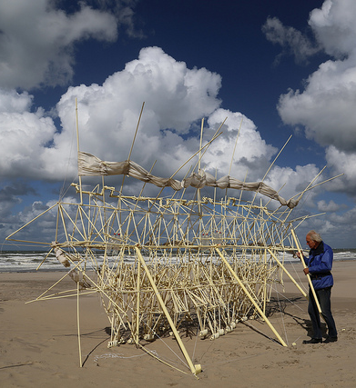
Strandbeast by Theo Jansen
http://www.strandbeest.com/

Slide 10
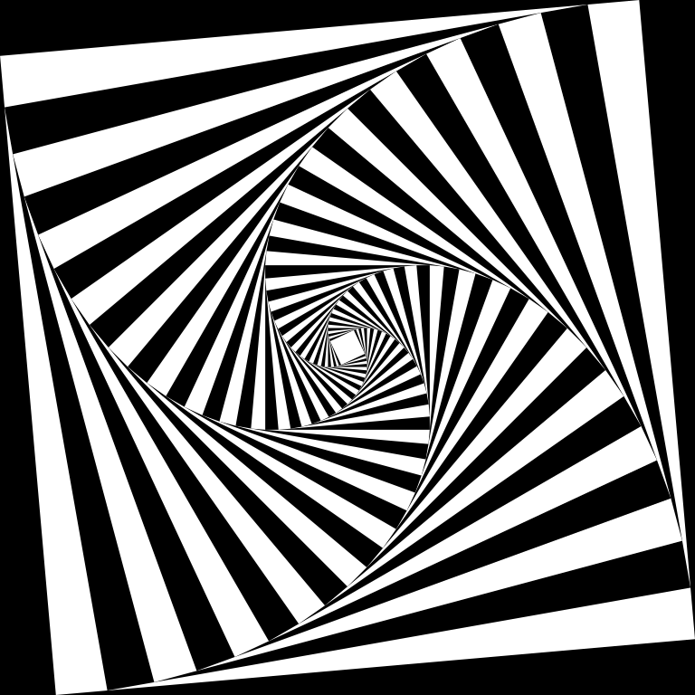
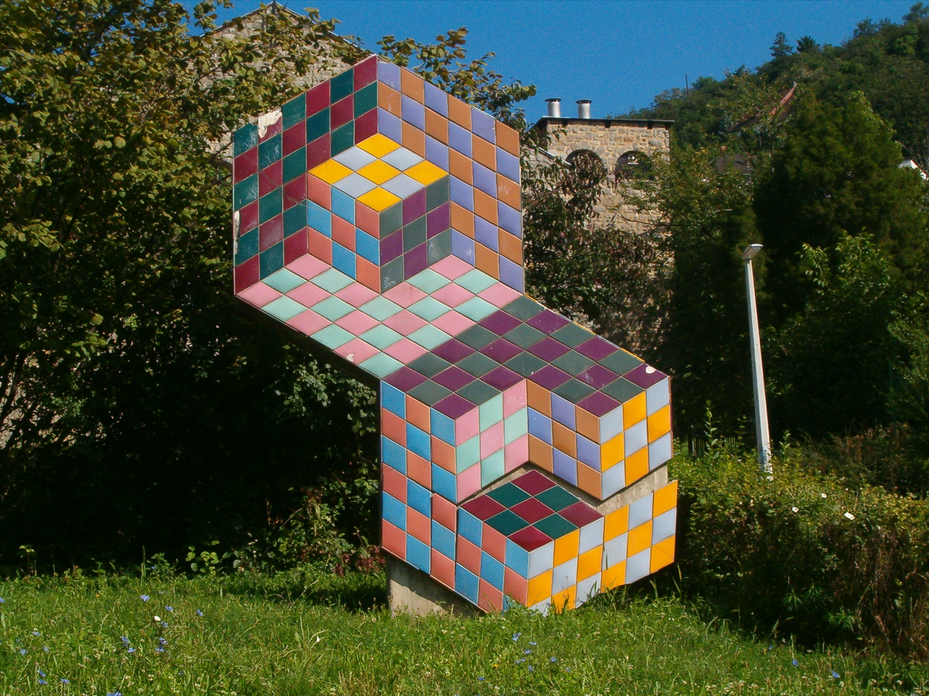
The art form flourished for a decade, but because of the popularity of the Op art movement, many artists lost interest.

Slide 11
In 1955, however, Kinetic Art became an international trend followed by artists such as …

Slide 12
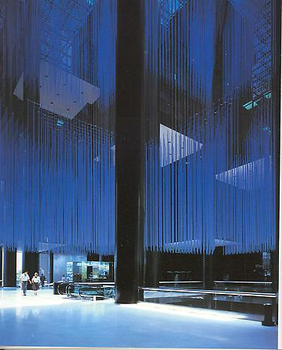
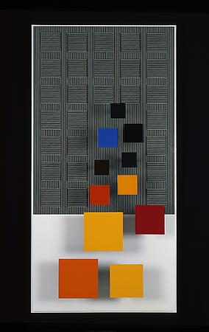
Jesús-Rafael Soto
Centro Banaven installation view, Caracas, Venezuela, 1979
Dos sonas de Color, 1999. Paint on wood, 60.2 in. x 30.3 in. x 6.7 in.

Slide 13
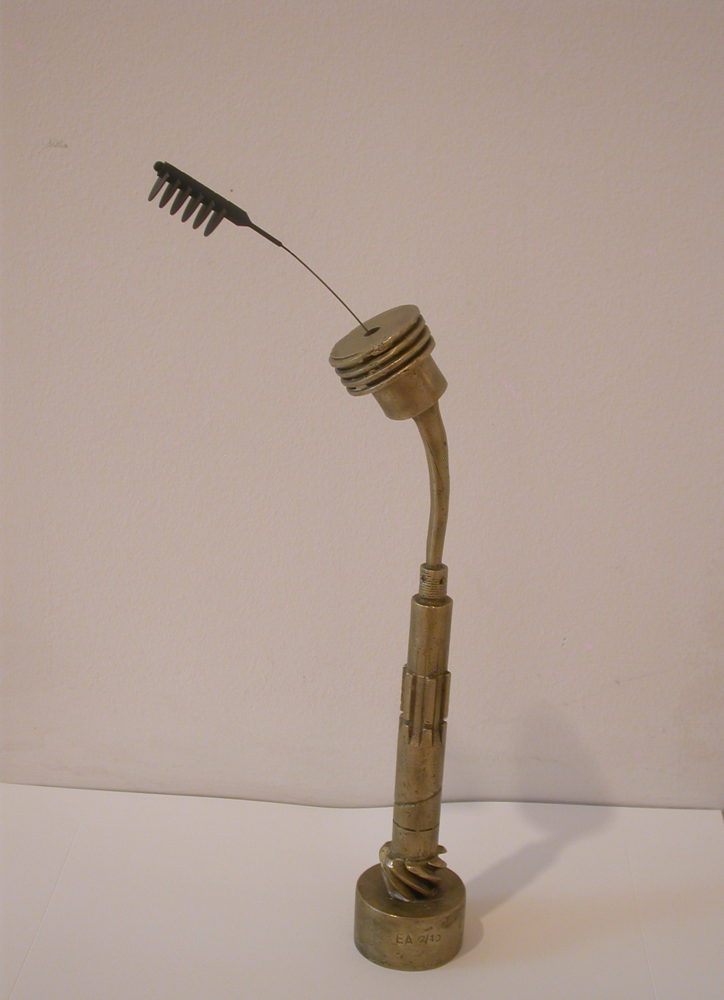
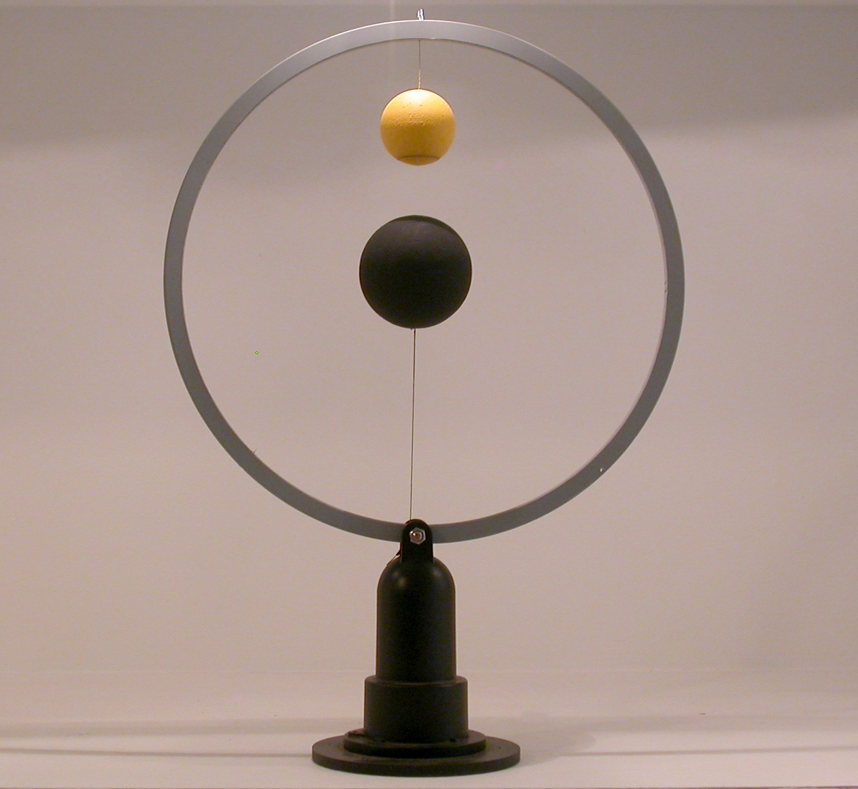
TAKIS (VASSILAKIS)
"Antigravity", 2000, magnet, iron, H 40 cm. D 27 cm.
"Flower", 2004, EA 5/10 , bronze,iron, H 47 cm.

Slide 14
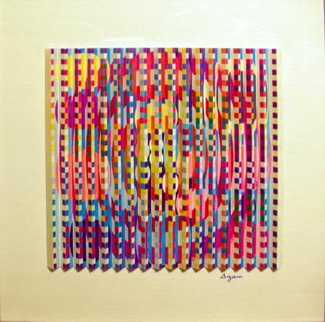
Yaacov Agam

Slide 15
Alexander Calder
(1898 – 1976)
Sculptor, Painter

Slide 16
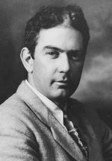
Alexander Calder
Alexander Calder was born in Lawnton, Pennsylvania on July 22, 1898 into a family of artists. The family moved to California when he was a boy. He began using scraps of wire he found in the street to make jewelry and beads for his sister’s dolls.

