Slide 1
I Am the Artist
IWB Pages

Slide 2
FIRST PAGE - You should write a project proposal. Hopefully you will be continuing to develop work you have previously begun to explore but in more depth. However, if there is something you think ties in your culture and is more personal to you, feel free to change

Slide 3
Make, on one page, an ideas mindmap. Jot down as many different words onto one page around your topic. Include general themes, inspiration, artists, media, techniques. Examples to follow

Slide 4
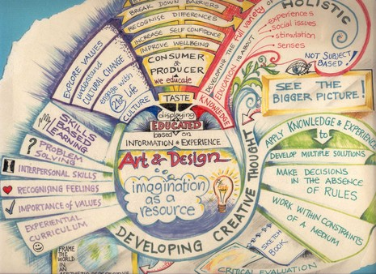
Could

Slide 5
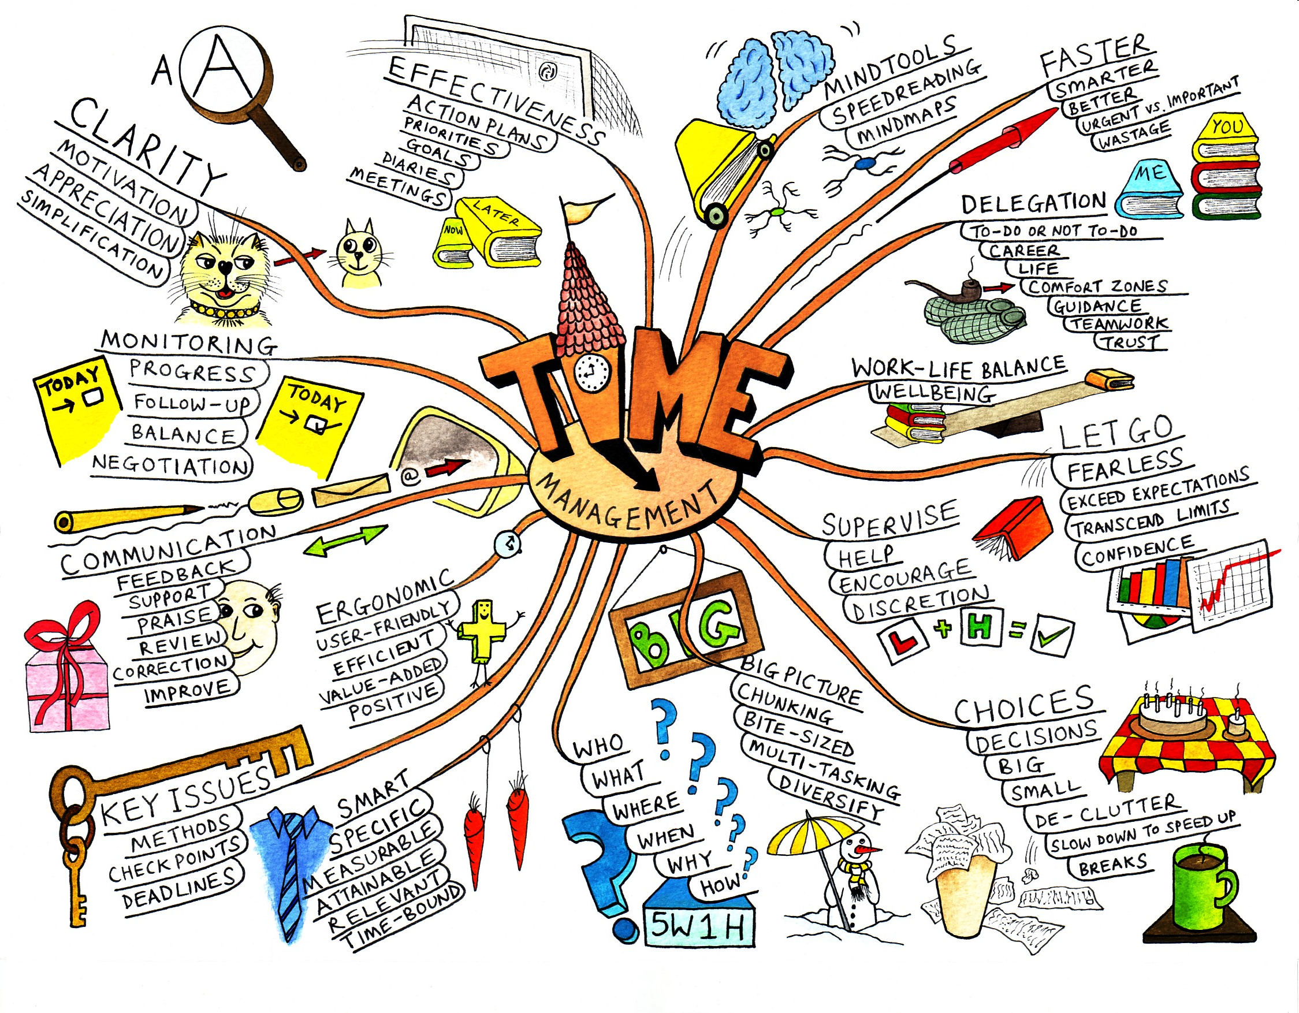
A mind map is a diagram used to represent words, ideas, tasks and other items that are related and linked to a central key word or idea

Slide 6
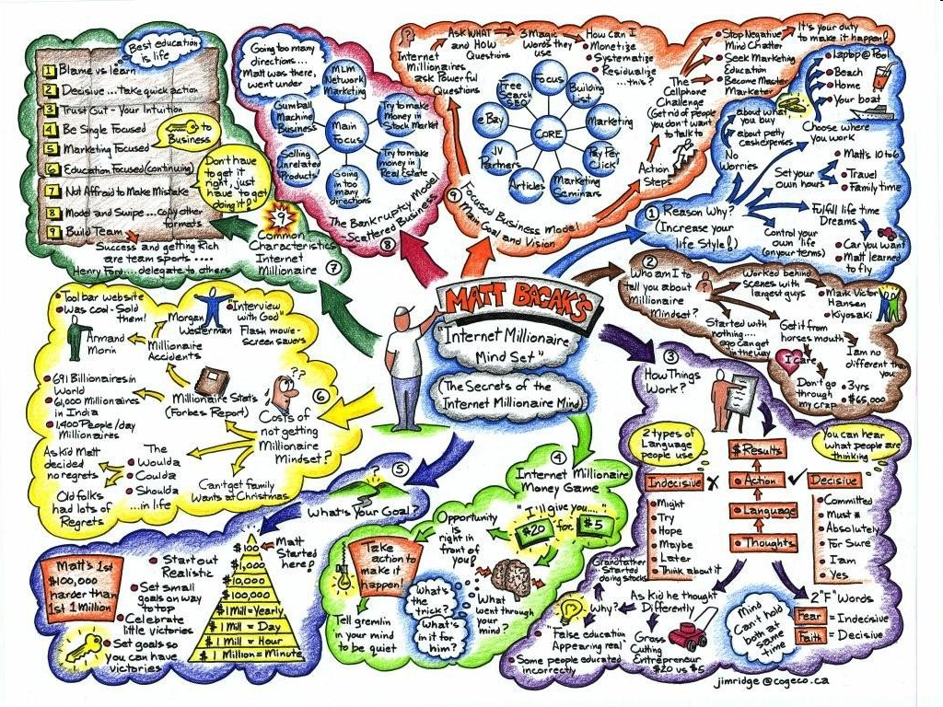

Slide 8
Go to www.art.sy.com, go to browse and search for 10 artists using key words from your mindmap. Write their names in the relevant places in the mindmap You can include images of each artwork. It will make your project clearer. Has your focus changed? Do you need to make your project more relevant?

Slide 9
CHoose two of the most relevant artworks and make artist research pages. Describe, ANALYSE compare and consider the art from different points of view. You can compare two by the same artist. You can compare with your own work. Make the connections

Slide 10
Article. Do not copy and paste the whole thing. This should be presented in your IWB and your ideas written and developed accordingly. Include images. Make sure you quote the article. Make sure you reference the article

Slide 11
1-2 media experimentation pages. Consider: The media and techniques (composition/light/paint application/concepts)your artists have used and experiment with this. Perhaps you already have on your artist pages. Try combining the artist techniques with some new ideas of your own. Or try some of the artists ideas but with another media Try your ideas but with another media.

Slide 12
Ensure you always write the process and REFLECT on your experiments.

Slide 13
Have you referenced everything??

Slide 14
Now it’s time to start your first studio work! Be brave Take Risks Contact me for ideas or help Spend time to ensure the finish is a high quality

