Slide 1
Giving yourself a background

Slide 2
What’s the benefits? LO: How to integrate a ground within your paintings or drawings.
While grounds are common in contemporary art, many students continue to draw or paint solely on unprimed, undecorated surfaces (usually plain white paper). This approach can be wholly appropriate – and, indeed, sometimes wondrous – however, for many projects, there are considerable benefits to being creative with the treatment of a painting surface .

Slide 3
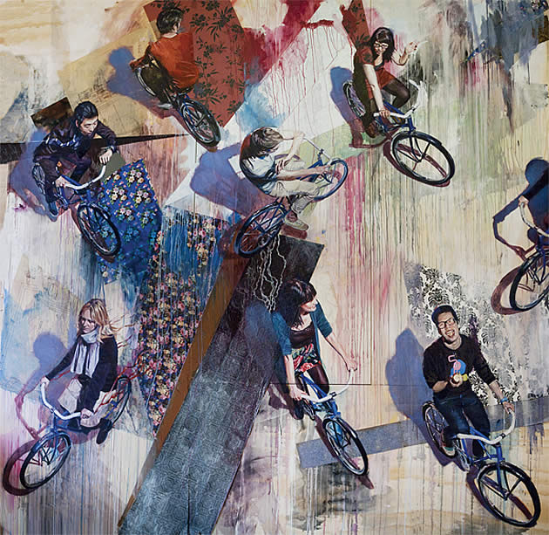
This intriguing painting by artist Andrew Young depicts tightly controlled images of people bicycling across a ground of streaming drips and collaged materials. The realistic figures and bicycles have a clever ambivalence towards one another, as they hurtle across the chaotic, unpredictable dance of running paint

Slide 4
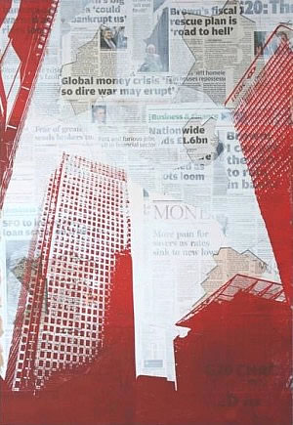
What is a ‘ground’? Short for ‘background’, a ground is the very first layer of paint (or other wet medium) applied to an artwork. It is an undercoat, which can either be covered entirely by subsequent media, or left visible in the final work. A white ground in this skilful A Level art print by Alexander Pavely partially obscures a layer of collaged newspaper. This makes the text less visible and allows the red buildings to stand out when printed over the top. It also makes the newspaper less absorbent, creating a better surface for the ink to print upon

Slide 5
Using a ground has several practical advantages, as well as some important aesthetic ones. For example:
Blending colours is easier. Most papers, canvases, timbers and fabrics are very porous. If you paint directly upon them, the moisture from the paint is absorbed almost immediately, resulting in paint that is difficult to spread and difficult to blend.
Paint dries richer and more vibrant. Without a ground to ‘seal’ a surface, paint dries prematurely and becomes slightly flat and dull in appearance; absent of its natural glossy sheen (if you have never used a ground, you won’t be aware of how full-bodied and beautiful paint can look when it is allowed to slowly evaporate dry).
You can paint on a greater range of surfaces. Many shiny materials, particularly composite boards (such as hardboard, which contains oil) repel acrylic paint. A professional primer such as Gesso (see below) is designed to adhere to such surfaces and to create a ground that is perfect for painting upon.

Slide 6
This painting by artist Kim Naumann has been completed on a collage of textured paper, such as wallpaper and gift cards. The blue and brown washes over the top has settled in the creases and indentations, highlighting the texture and creating a beautiful ground for the painting.

Slide 7
Texture. A ground can be used to smooth over imperfections in the underlying surface or to create new texture.
Flimsy papers can be strengthened. A sheet of paper becomes stiffer and more resilient when covered with a thick ground (sometimes painting both sides is necessary, in order to minimise warping). A sturdier piece of paper is especially beneficial if later adding collage or heavy elements to a work.
It allows you to easily cover underlying colours. A thick primer reduces the number of layers needed to cover a intensely coloured surface.
Paintings can be finished faster. If a ground remains partially – or completely – visible in a finished work, the painting can often be finished much faster. At a very simple level, your work is already partially done: the canvas is covered entirely from the start (time is usually of vital importance for high school art students who are obligated to complete work within tight time frames).

Slide 8
This painting by artist Ian Francis has been painted on a black ground. Black forces you to apply thick (or many) layers of paint and it can help create deep, brooding shadows.

Slide 9
Paintings can look more ‘authentic’, as if they belonged to a ‘real’ artist.
Why? Because grounds encourage layers and in doing so, give a greater opportunity for the artist to really interact with the work; their soul to be tangled within it. Layers give history and depth.

Slide 10
This amazing painting by Michael Shapcott features layers of colour: splashes / washes / drips that have been worked over, creating a rich, vibrant, multi-layered work.

Slide 11
In the example to the right, by Jane Mitchell, a semi-translucent baby’s pram has been painted over a textural background – creating the impression of a decaying wall surface. The work suggests urban decay: forgotten moments in time; a snapshot of human existence in a crumbling, eroding world.

Slide 12
Expressive drawing with pastel on acrylic ground: perfect use of media for sketchbook exploration

Slide 13
Acrylic Washes / Ink Washes / Watercolour Grounds
When you make a ground using a watery medium, it dries in beautiful, unexpected patterns. Two beautiful works by Stella Im Hultberg on a ground of tea-stained paper.

Slide 14
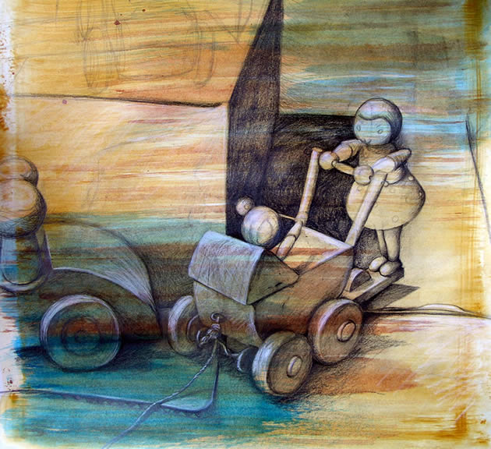
This drawing by Amiria Robinson, was completing using graphite and white pencil upon acrylic wash. The ground was created using three different colours of watered down acrylic (yellow ochre, then red umber then cool blue), applied while the previous layer was still wet, with a large, flat, dry-bristled brush

Slide 15
This beautiful ‘A’ grade IGCSE Art examination final piece was created by Georgia Shattky, while studying at ACG Parnell College. The ground was created using subtle acrylic washes, with the fruit, vegetables and fabric folds drawn over the top using coloured pencil. Cleverly composed and accurately drawn, the mottled ground gives this work a creative element that lifts it out of the ordinary.

Slide 16
Carefully placed blocks of coloured wash can be used to direct the viewer’s attention, as in this image by Graham Smith

Slide 17
Painting over a beautiful ground of drips

Slide 18
Conclusion
Using a ground often results in the creation of rich, multi-layered works that have a history to them; buried marks that fill them authenticity. Instead of being superficial or surface-deep, your painting becomes the work of an artist: filled with song.

