Slide 1
Compare and Contrast Analyzing an art work through study of composition

Slide 2
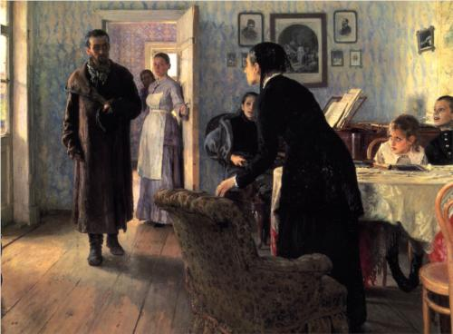

Slide 3
Composition: where does the eye look first?
Unexpected visitors - 1888
What shape did your eye follow? Was there an area where you kept returning?

Slide 4
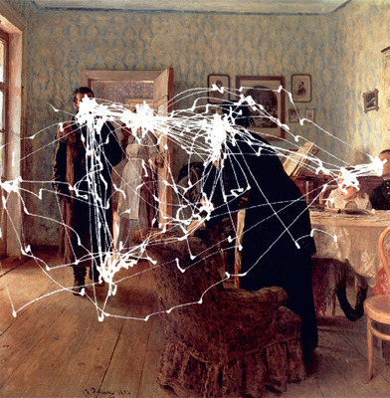

Slide 5
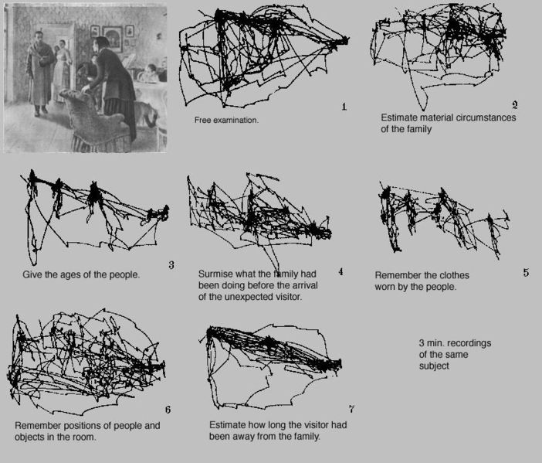

Slide 6
Where do you look first?
Look at the art, what the first thing you looked at?
Why did you look at that first?
Was it the colours?
Was is because its where the detail is?
Or are there more hidden things?

Slide 7
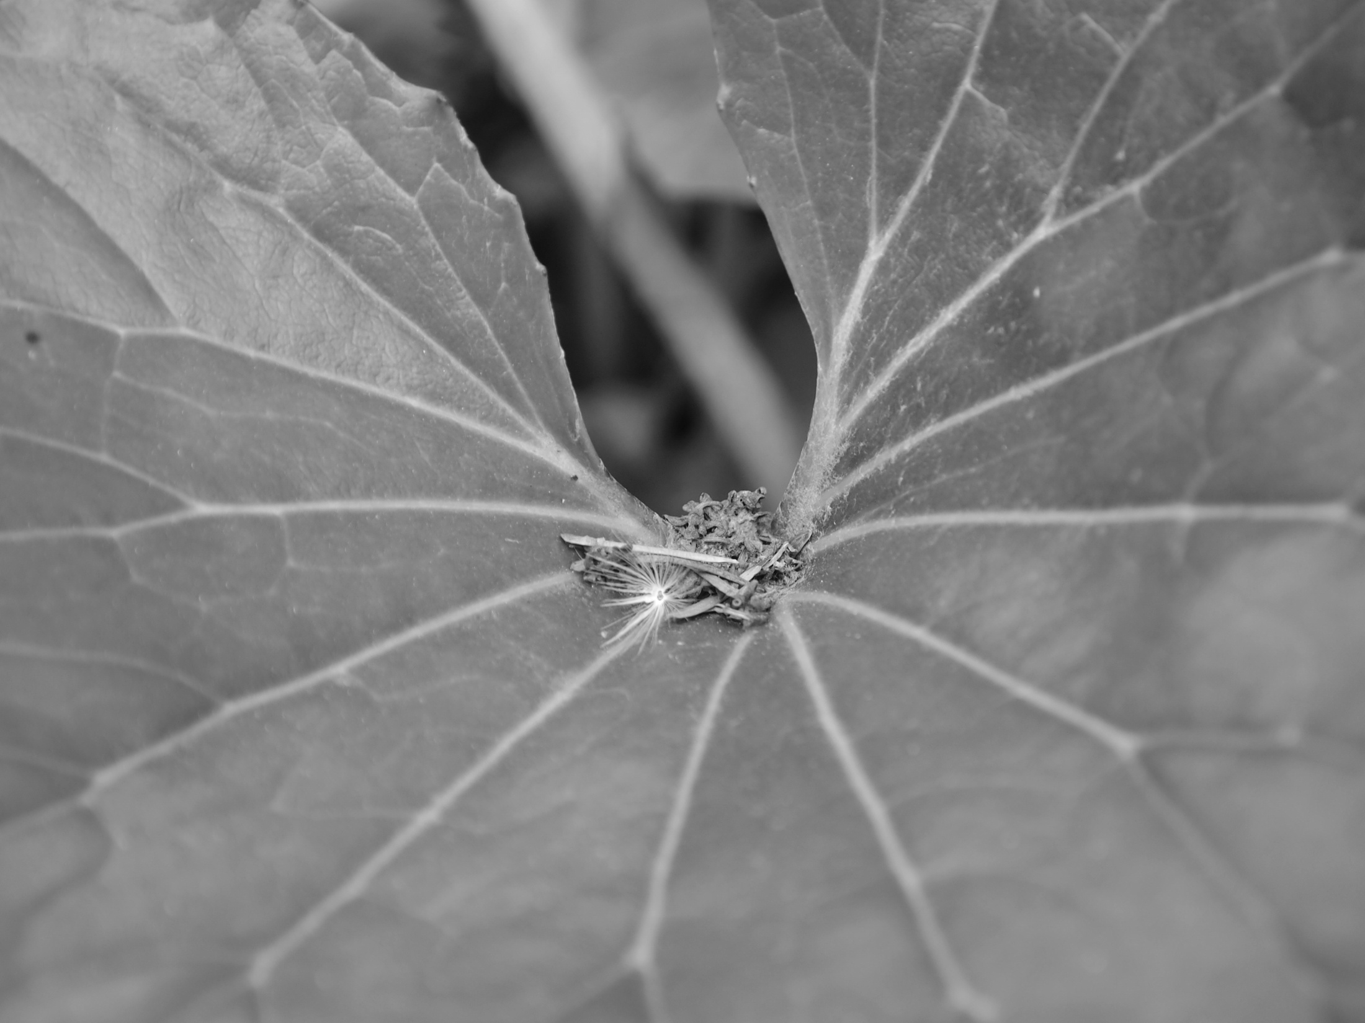

Slide 8
WHAT MATERIALS AND TECHNIQUES HAS THE ARTIST USED?
Have they used paint/collage/wood/metal/bones?
Is it a painting/sculpture/collage?
How have they used the paint(or other material)?
How is the texture? Is it smooth? Is rough?

Slide 9
WHAT COLOURS DOES THE ARTIST USE? WHAT MOOD DOES THIS CREATE?
Pastels tones
Shadow
Contrasting
Complimentary
Vivid
Blended
Sepia
Dirty
Bright
Light
Monochrome
Black and white
Repeating
Soft
Heavy

Slide 10
What composition has been used?
Look at your composition study: Which one fits your artists image and why do you think the artist choose that one?
Rule of thirds
Triangles
Patters
Symmetry/a-symetrial
Why have they used this composition?

Slide 11
Opinion
WHAT DO YOU LIKE ABOUT THEIR WORK?
Do not say I like it because its beautiful/pretty. Why is it beautiful

Slide 12
WHY HAVE YOU CHOSEN THIS PICTURE TO PUT IN YOUR BOOK? HOW IS THIS WORK GOING TO INFLUENCE YOU?

Slide 13
COMPARE AND CONTRAST
Repeat the process for a second art work
What things are the same and what things are different?

