Slide 1
How are you going to use color?
Wonderful beautiful Color

Slide 2
Colour
There are a lot of theories and ideas about how color affects mood, composition and therefore photographs, but for at the most basic level, color can be separated into two very general categories: cool and warm.

Slide 3
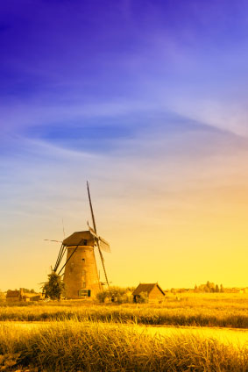
Complimentary, analogous and monochromatic color
Complimentary –
2 colors from opposite sides of the color wheel

Slide 4
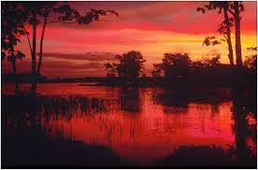
Complimentary, analogous and monochromatic color
Complimentary –
2 colors from opposite sides of the color wheel
Analogues –
Colours close together on the color wheel

Slide 5
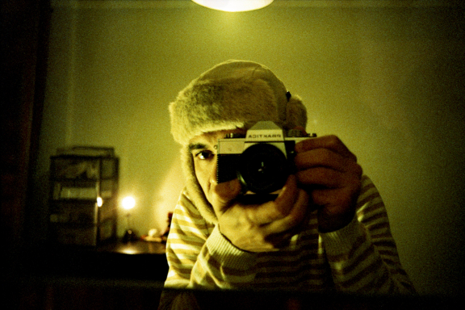
Complimentary, analogous and monochromatic color
Complimentary –
2 colors from opposite sides of the color wheel
Analogues –
Colours close together on the color wheel
Monochromatic –
Colors that are the same but vary in hue or tone

Slide 6
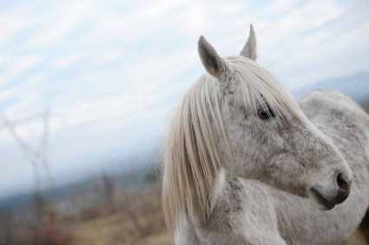
Colour Saturation
Refers to the richness of the color. An image with dull colors, such as a pale green meadow on an overcast day, has very low color saturation. A field full of bright orange pumpkins on a sunny morning, on the other hand, has very high color saturation

Slide 7
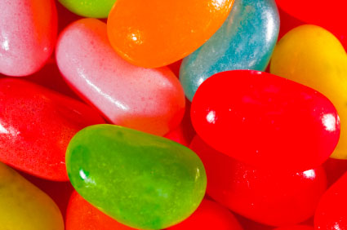
Controlling Color
Color is a wonderful tool for creating an engaging image, but it’s very easy to go overboard with it. Complimentary colors can look striking together, but too much color can make your viewer cringe.
If your scene contains a very strong, bold color in the foreground, don’t include a lot of other bold colors in the surrounding scenery or in the background. Too much color is confusing to the eye and will make for a feeling of chaos.
Controlling Color

Slide 8
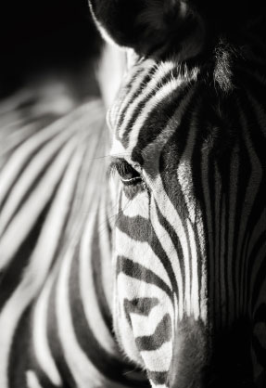
Know when not to use color
Some images just look better in black and white. You may choose to completely desaturate an image (which is just another word for making it black and white) if you find that there are too many colors distracting you from the composition or the subject itself. Conversely, black and white is a good choice when the colors in a scene just aren’t that interesting or present. You may also want to use black and white if the contrast in the image calls for it – for example, if there is a good range of tones between the highlights and the shadows

Slide 9
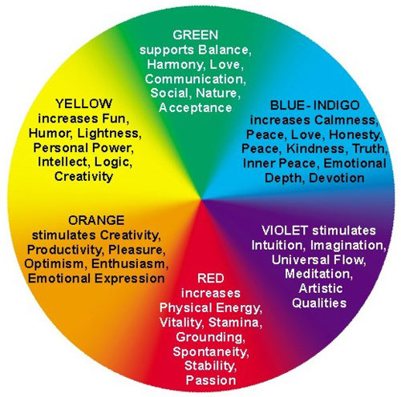
Colour Guide

Slide 10
