Slide 1
How to make a Alex Calder mobile

Slide 2
Alexander Calder
(1898 – 1976)
Sculptor, Painter

Slide 3
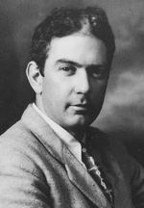
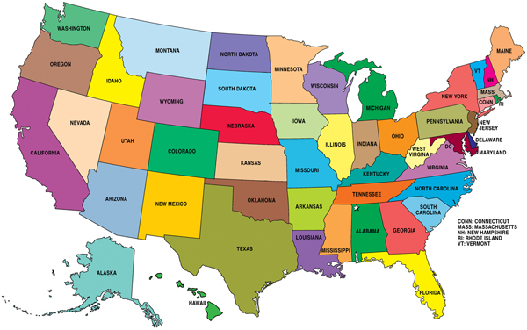
Alexander Calder
Alexander Calder was born in Lawnton, Pennsylvania on July 22, 1898 into a family of artists. The family moved to California when he was a boy. He began using scraps of wire he found in the street to make jewelry and beads for his sister’s dolls.

Slide 4
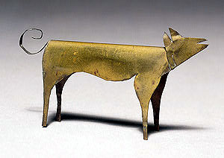
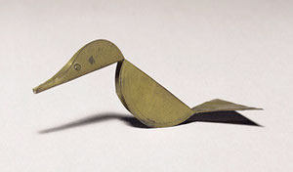
Dog (1909)
When he was in fourth grade, he sculpted a dog and a duck out of sheet brass as Christmas presents for his parents. The duck was “kinetic” because it rocked when touched. During his high school years, his family moved back and forth between New York and California. He studied mechanical engineering in college, graduating in 1919. For the next several years, he worked as an engineer, but finally he decided he would like to be an artist.
Duck (1909)

Slide 5
The Flying Trapeze (1925)
He moved to New York and enrolled in the art students’ League. One of his assignments was to sketch the Ringling Bros. Barnum & Bailey Circus. He became very interested in the circus, and would continue to create circus inspired art all through his career. In 1926, he moved to Paris and took up with a community of artists. He began to make toys, creating his “Cirque Calder”, a miniature circus made of wire, string, rubber & cloth. He made it small so he could fit it into a suitcase, allowing him to travel around giving “circus shows”.

Slide 6
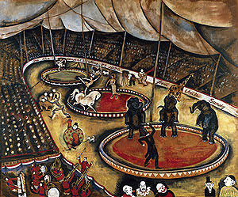
Circus Scene (1926)
The artist working on Cirque Calder wire sculpture (1929)

Slide 7
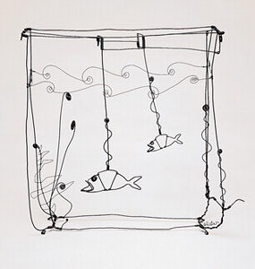
Cirque Calder sparked his interest in wire sculpture and kinetic art. (kinetic means pertaining to motion). He used his knowledge of engineering to create movable sculptures. Some of his circus characters could “perform” while suspended from a thread. His friend, artist Marcel Duchamp, dubbed these sculptures “mobiles” after the french word meaning mobile and motive. His early kinetic sculptures used cranks and pulleys to make them move. Later, his work was more delicate, and they only needed the current of the air to make them move.
Goldfish Bowl (1929)

Slide 8
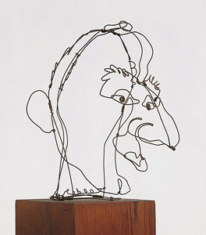
Jimmy Durante (1928)
Durante was a popular movie actor with a famously huge nose.
Circus Scene (1929)

Slide 9
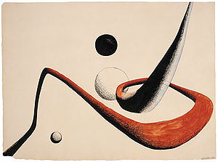
Space Tunnel (1932) (painting)
He bought a farmhouse in Connecticut where he raised his family while giving Cirque Calder performances and designing moving stage sets and ballet scenery.
Pantograph (1931)

Slide 10
Steel Fish (1934)

Slide 11
During WWII, he tried to join the marines, but was rejected, so he went back to work on his scuptures. The war caused a shortage of metal, so he turned to wood as a material.
Model for the New York Workd’s Fair (1938)

Slide 12
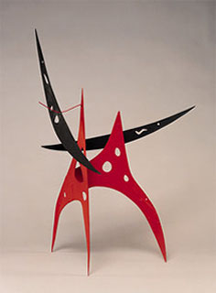
Lily of Force (1945)
Sword Plant (1947)

Slide 13
Finny Fish (1948)

Slide 14
Triple Gong (1951)

Slide 15
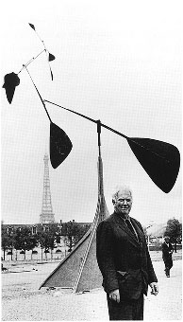
In the 1950s, he started producing huge sculptures for public places.
.125 (for JFK airport) (1957)
La Spirale (1958)

Slide 16
In 1962, he moved to France, into a new, ultra-modern workshop. He made models of his giant sculptures, which were then handed off to metal workers to fabricate. Calder watched over their work to make sure they executed his design perfectly. The big sculptures were made of carbon steel. His mobiles were mostly aluminum.
L’Homme (man) (1967)

Slide 17
Calder created this sculpture in 1971 to be installed at the entrance of the World Trade Center in New York City. On September 11, 2001, the sculpture was destroyed when the World Trade Center collapsed after being struck by two terrorist-hijacked airplanes.
WTC Stabile (Bent Propeller) (1971)

Slide 18
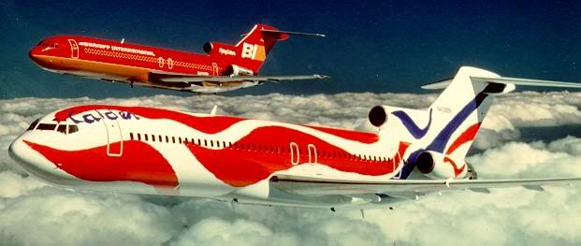
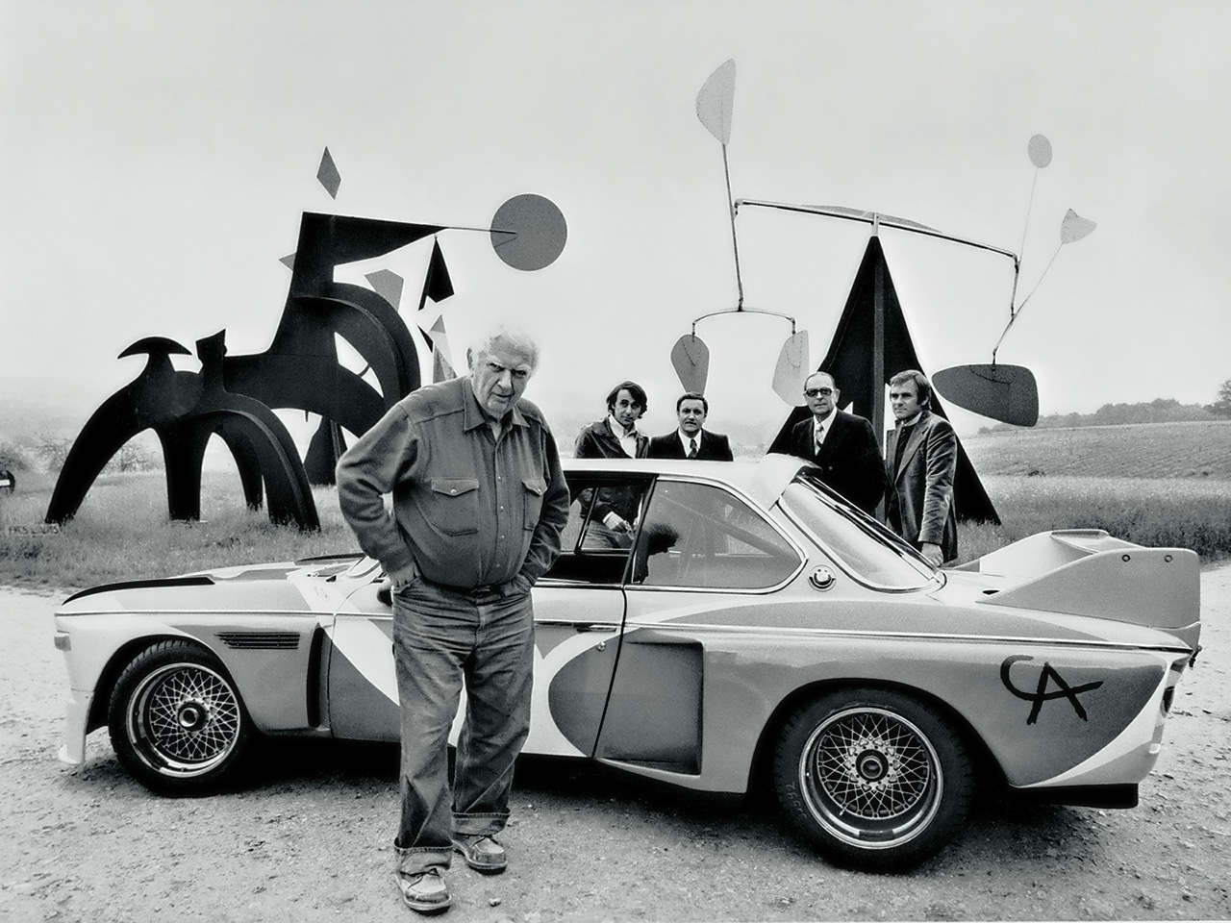
In 1973, Braniff Airlines hired him to paint a full size DC-8 plane–“a flying canvas”. He painted another plane in 1976 for the U.S. Bicentennial. In 1975, BMW hired him to paint a BMW 3.0 CSL (car) which launched the BMW car project (lots of other artists followed with their own car paintings).

Slide 19
Alexander Calder died on November 11, 1976.
Two months after his death, he was posthumously awarded the Presidential Medal of Freedom – the United States’ highest civilian honor.
His family boycotted the ceremony as a protest to the war in Vietnam.

Slide 20
How to make a mobile
Think of an image, symbol, or subjects that are related to each other.
Think of a design you would like to have your mobile represent.
Using found materials, create your shapes. Color or paint them as needed.
Use wire and wire cutters to create your structure for your mobile.
Make sure it has rhythm and balance!

Slide 21
Things to remember...
You need to have at least 4 or more shapes to have balance.
Your shapes can be made out of everyday materials like cardboard!
You need to think of a strong structure for your base (top). You may need to double up materials.
If your wire seems to flimsy, you can always wrap it together... it gives it a cool effect as well!
When you create your mobile as a whole, think about not only the shapes, but how you hang your wires to make it have balance!

Slide 22
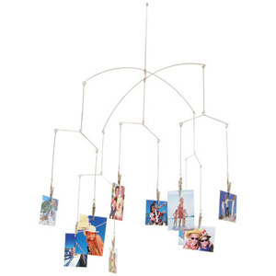
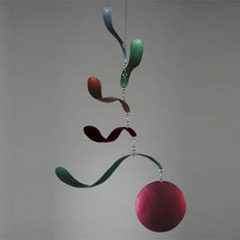
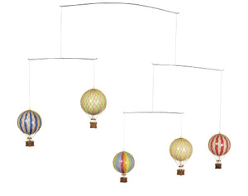
Good examples

Slide 23
Remember!!! Your mobile needs to…
Not be too heavy for the wire we have (you may need to double the wire up)!
Have movement and balance.
Have shapes and symbols that relate to each other.
Have an overall good kinetic design.

Slide 24
Materials
Paper, found objects, etc.
Cardboard or mat board
Wire, wire cutters
Paint
Whatever works for your design!

